Slide 1
Interdisciplinary Research
in the era of Generative AI
Meng Jiang
Department of Computer Science and Engineering
University of Notre Dame

Slide 2
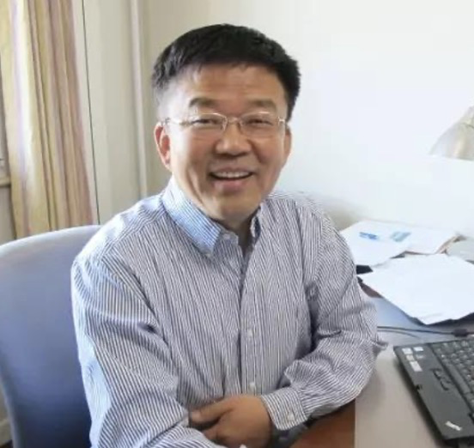
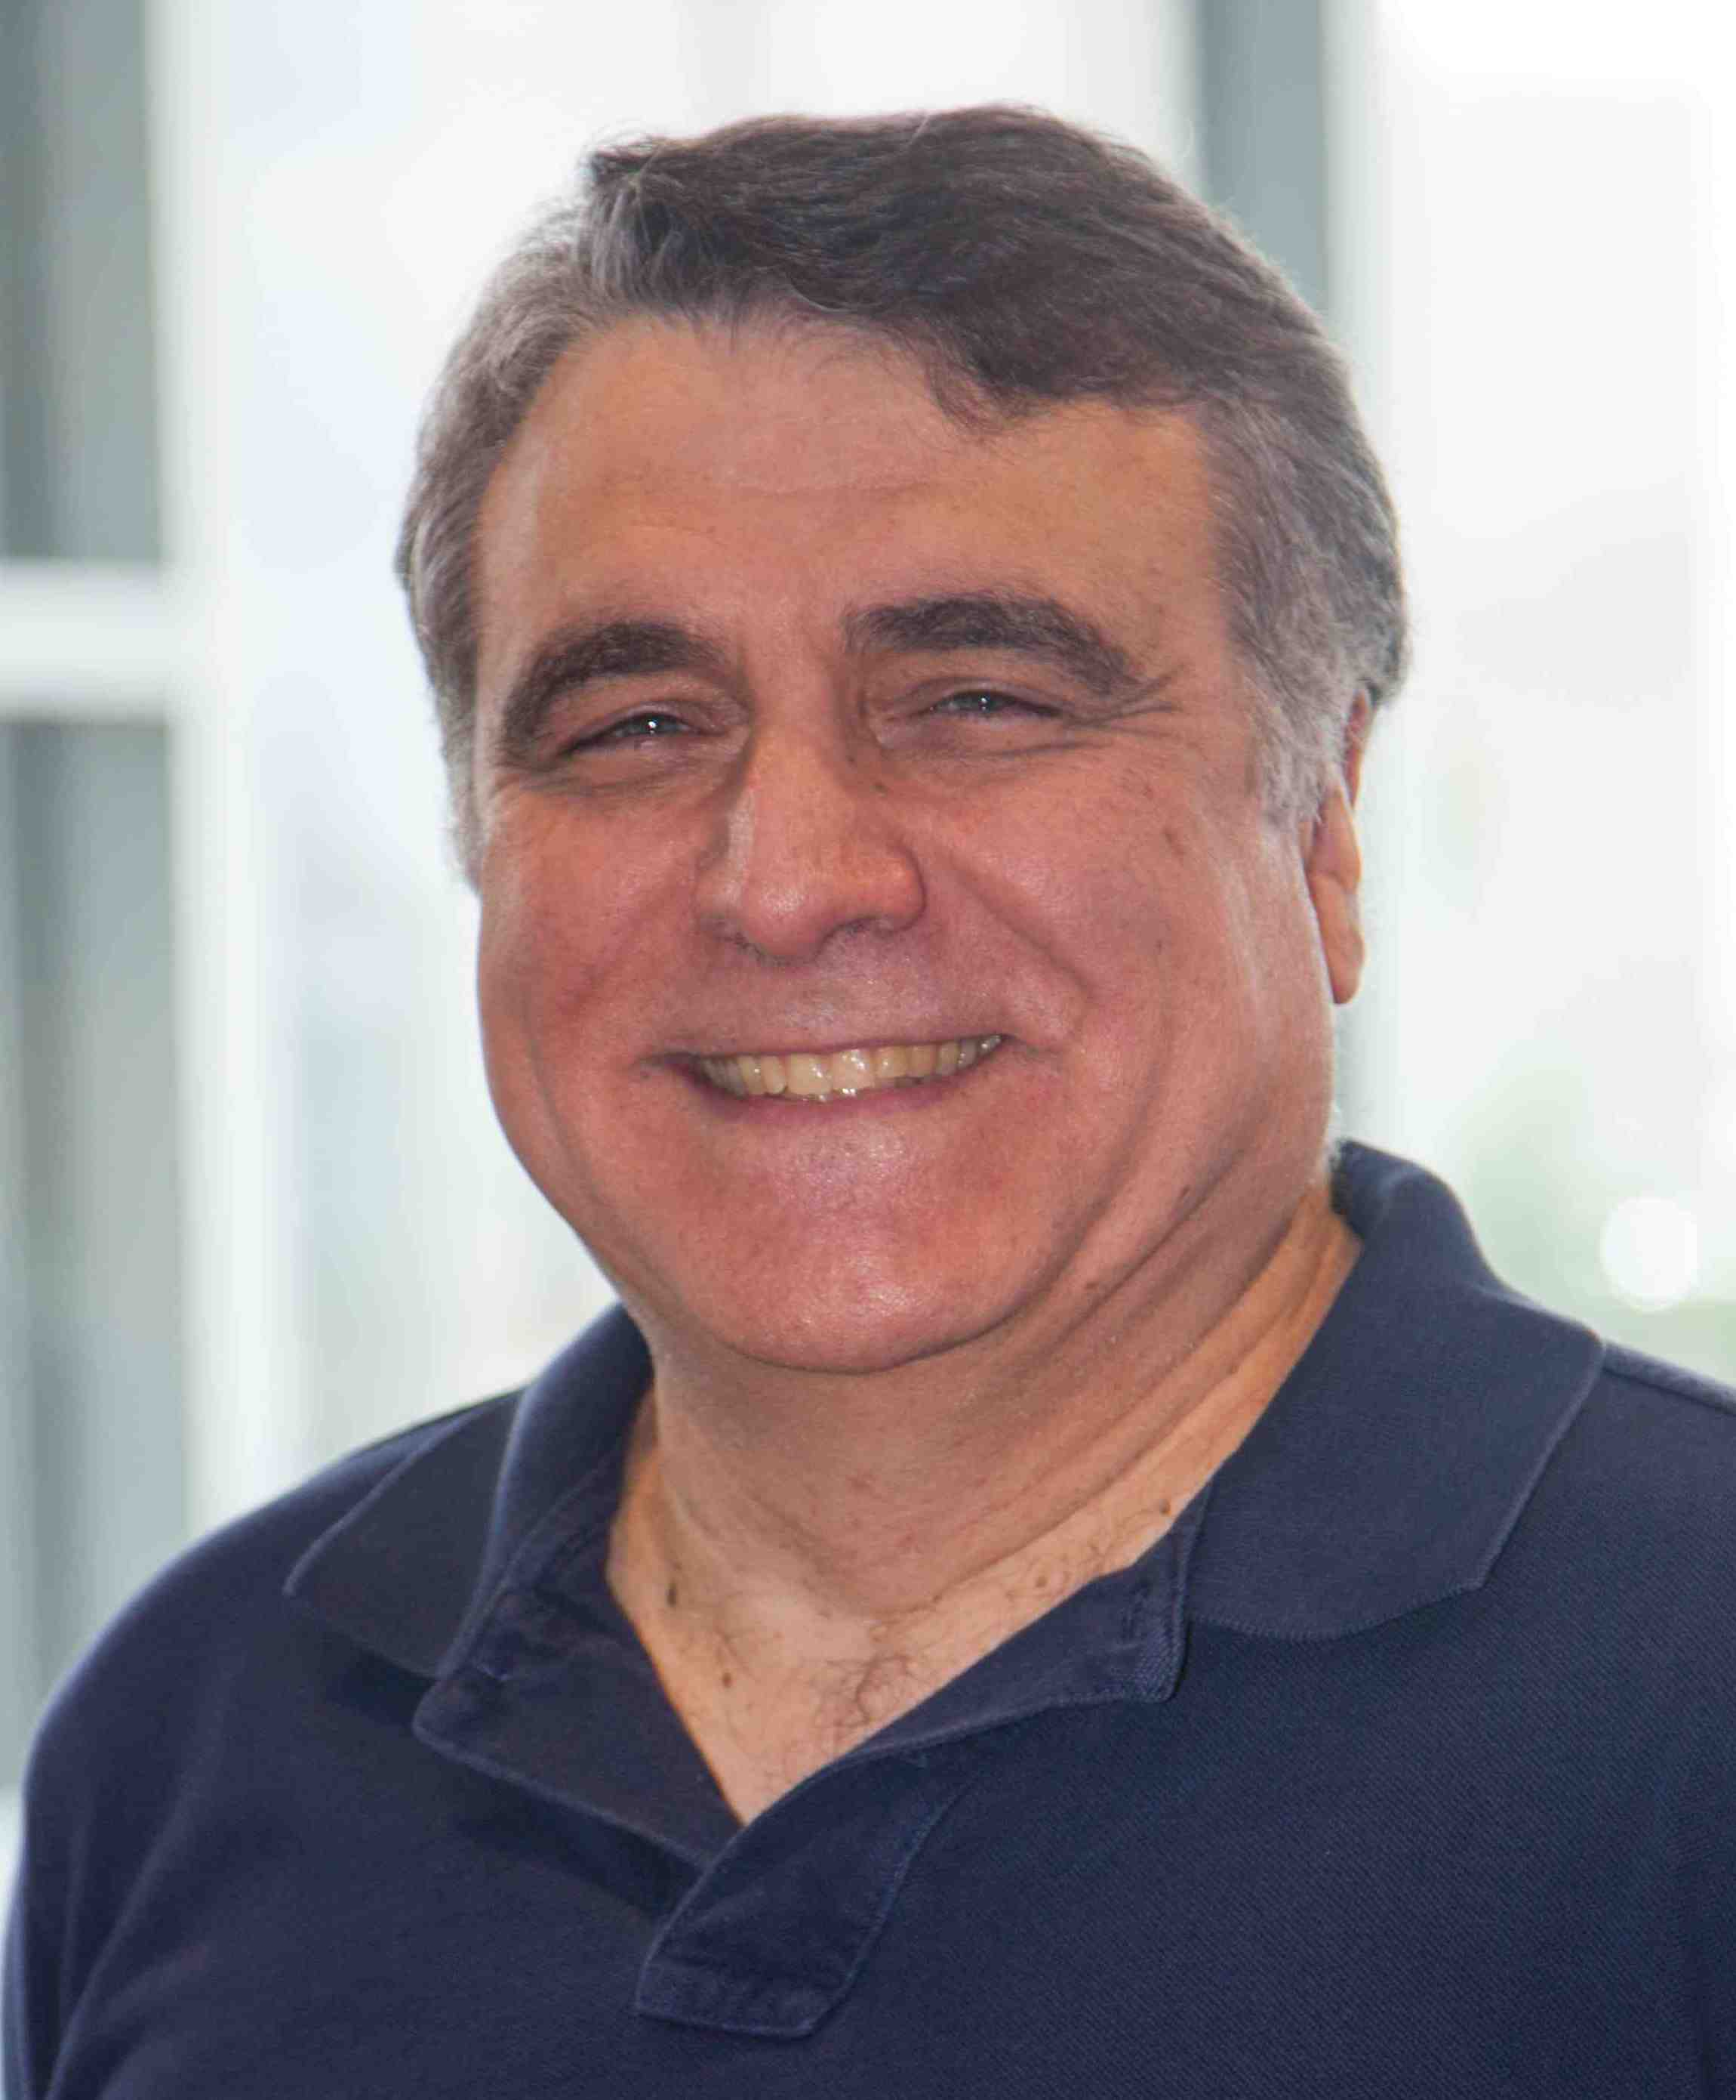
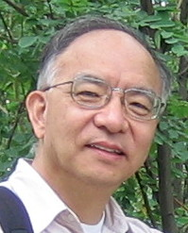
My Background
Graph and Text Data Mining: The process of knowledge discovery
Given a very large text-attributed graph, how to predict links for low-degree nodes? (Social recommendation)
Jiang et al. Social context recommendation. CIKM 2012.
Jiang et al. FEMA: … for dynamic behavioral pattern discovery. KDD 2014.
Tsinghua
(2010-2015)
Given a very large graph, how to detect suspicious nodes? (Fake account detection)
Jiang et al. Catchsync: Catching synchronized behavior in large directed graphs. KDD 2014. (Best paper finalist)
CMU
(2012-2013)
Given a very large corpus, how to build a knowledge graph with minimal human effort? (Information extraction).
Jiang et al. MetaPAD: Meta pattern discovery from massive text corpora. KDD 2017.
UIUC
(2015-2017)

Slide 3
Discover Knowledge for Broader Impact
Besides social network analysis and information systems
KDD is mining useful and/or surprising patterns from big messy data.
Data processing, data engineering, data mining … on graph and text data
Generative AI is bringing surprises:
A piece of accurate answer, a piece of nice story, an image or a 1-min video created from a few sentences…
Thanks to the big data and all data techs that make it less messy for exhaustive training.
Generative models are making small data useful and impactful.
What can we do with graph and text generative models?
This talk introduces a few interdisciplinary research projects at Notre Dame DM² Lab.

Slide 4

WARNING
This talk contains different types of techniques and has very limited detail. For the detail, you are welcome to ask questions at the end of the talk. You can find related papers cited at the bottom of slides.
Slide numbers are at the bottom right to help Q&A. Pages 23 and 34 may help you write a summary. Pages 7, 8, 11, 21, 32 may help too.
This talk would not be possible without our collaborators
and amazing students that you will find at the top right.
[1] XX et al. (20XX). XXX, XXX.

Slide 5
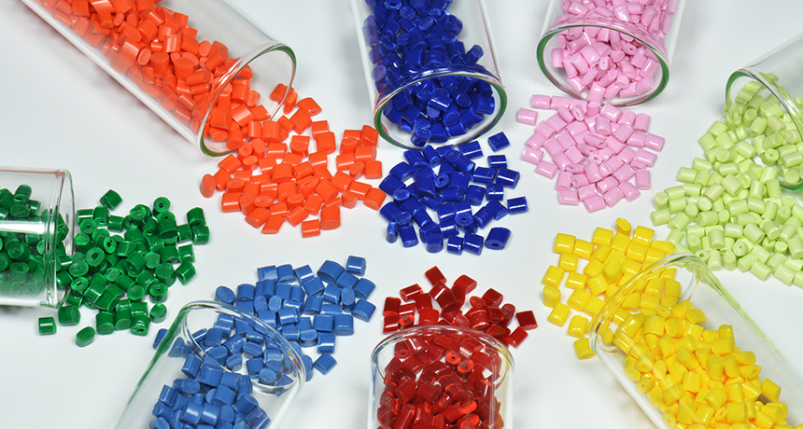


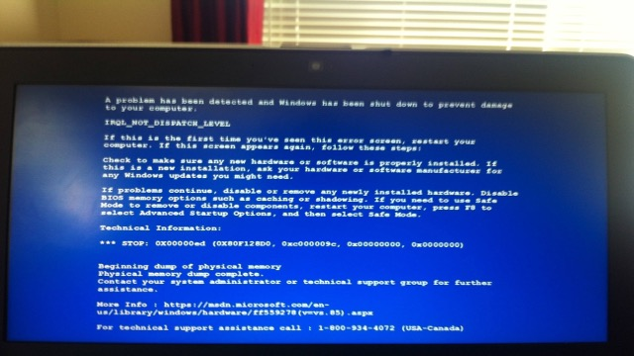

Material Science
Online Education
Software & Network Security
Mental Health

Slide 6
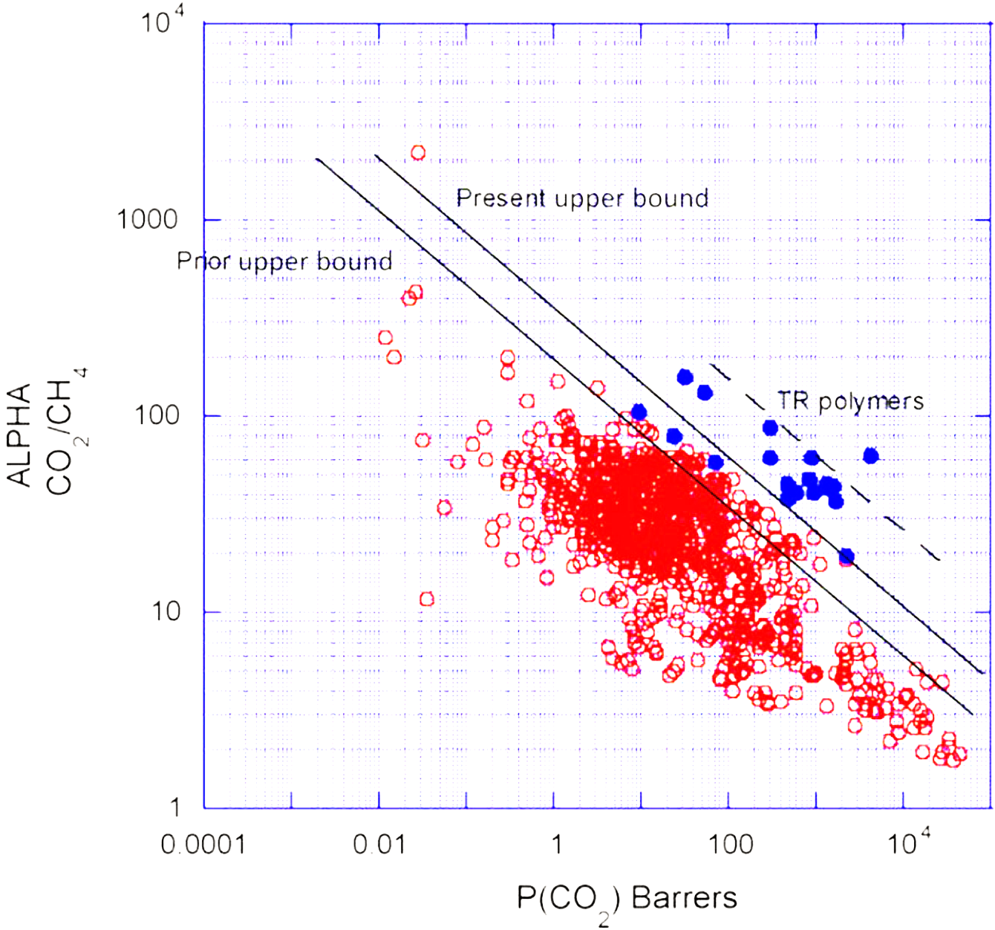
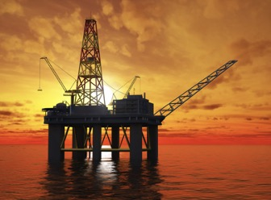
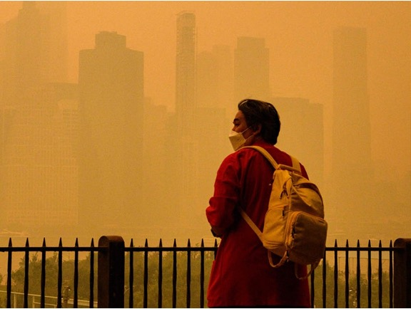
Gas-separation Polymer Material [1]
Ideal polymer material
CO₂
CH₄
CO₂
Other gas
O₂
Selectivity
O₂
Permeability
[1] Barnett et al. (2020). Designing exceptional gas-separation polymer membranes using machine learning. Science Advances, 6(20), eaaz4301.
Notes:
Methane, highly flameable

Slide 7
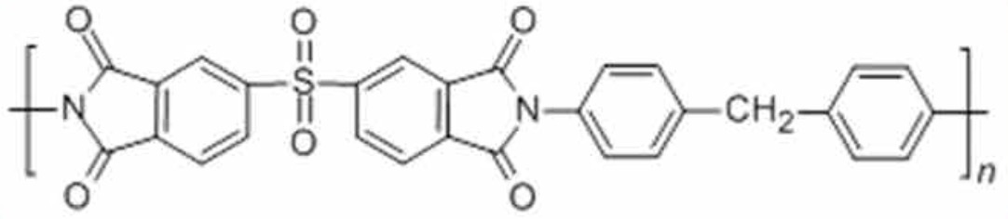
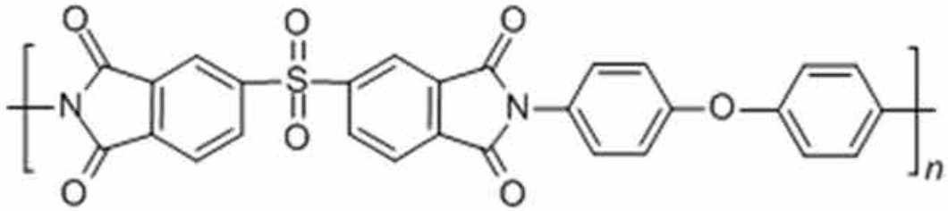
Research on Polymer Discovery
Red points: ~700 polymeric constructs that have been measured to date (60+ years)
1991 Robeson upper bound [1]
Blue points: “Thermally rearranged (TR) polymers, which are considered the next-generation of membrane materials because of their excellent properties”
2008 Robeson upper bound
Selectivity
Permeability
[1] Tena et al. (2016). Claisen thermally rearranged polymers. Science Advances, 2(7), e1501859.

Slide 8

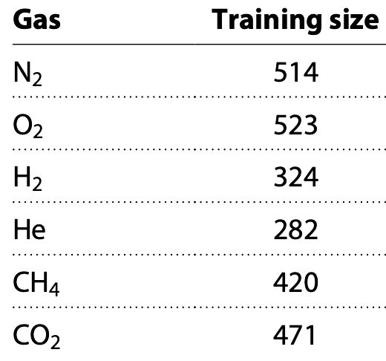
Graph Regression
Supervised Learning: Training sets of ~500 examples are too limited.
Problems in Graph Machine Learning
Imbalanced Learning: Predictions on minor (continuous) labels are equally or more important than those on major labels.
Red points: ~700 polymeric constructs that have been measured to date (60+ years)
Blue points: “Thermally rearranged (TR) polymers, which are considered the next-generation of membrane materials because of their excellent properties”
Interesting but
hard to predict
DATA
Permeability
Over 1.2 million
unlabeled points
Six different gases
Transfer Learning: Extra data points, labeled or unlabeled, the same domain or different domains, could be useful.
[1] Tena et al. (2016). Claisen thermally rearranged polymers. Science Advances, 2(7), e1501859.

Slide 9

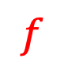

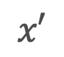
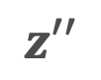
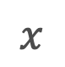
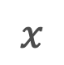

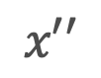
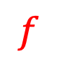

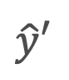

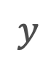
Data Augmentation
in Machine Learning
What is data augmentation?
Data augmentation techniques are used to increase the amount of data by adding slightly modified copies of existing data or newly created synthetic data from existing data. It helps reduce overfitting when training machine learning models. — Wikipedia [1]
Supervised learning Self-supervised learning
$$f$$
$$g$$
$$f$$
$$x$$
$$z$$
$$\hat{y}$$
$$y$$
augment
$$x′$$
$$z′$$
augment
$$x$$
$$x′$$
$$z′$$
$$\hat{y}′$$
$$x′′$$
$$z′′$$
[1] https://en.wikipedia.org/wiki/Data_augmentation

Slide 10
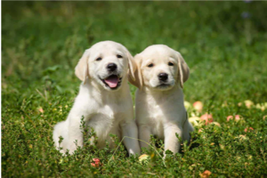
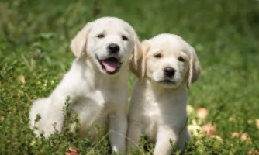
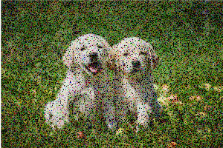
Data Augmentation
in Computer Vision and NLP
Cropping
Flipping
Data augmentation improved learning.
Image and text data could be augmented.
Heuristics were effective for augmentation.
Rotation
Add noise [1]
Synthetic nodes / links in a large graph?
Dependencies have to be learned to augment data.
“… awesome …”
“… amazing …”
Synonyms [2]
“amazing”
“awe-inspiring”
“awing”
…
[1] Zhong et al. “Random erasing data augmentation.” AAAI 2020.
[2] Wei et al. “EDA: Easy data augmentation techniques for boosting performance on text classification tasks.” EMNLP 2019.

Slide 11
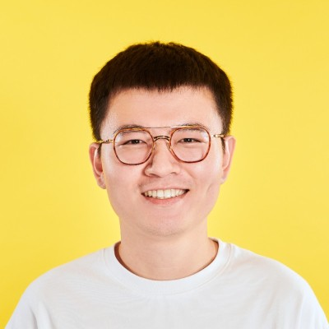
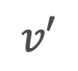
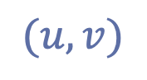
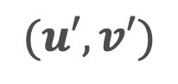

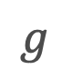
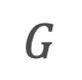
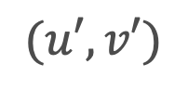
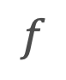
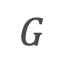
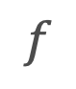
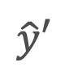


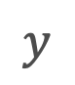
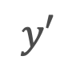


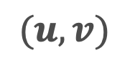
Data Augmentation for GNNs
AAAI’21, ICML’22, LoG’22
Tong Zhao (Snap)
$$G$$
$$g$$
Link prediction (addition and removal) created synthetic nodes in a large graph.
Improved node classification accuracy by relatively +17% [1].
Counterfactual link labels improved link prediction Hits@20 relatively by +16.4% [2].
Learning to augment is effective for graphs.
$$f$$
$$v$$
$$v$$
$$\hat{y}$$
$$y$$
Link predictor
$$v′$$
$$v′$$
$$\hat{y}′$$
$$f$$
arbitrary
$$(u,v)$$
$$(u,v)$$
$$\hat{y}$$
$$y′$$
$$G$$
Node pair matching
$$G$$
$$(u′,v′)$$
$$(u′,v′)$$
[1] Zhao et al. “Data augmentation for graph neural networks.” AAAI 2021.
[2] Zhao et al. “Learning from counterfactual links for link prediction.” ICML 2022.

Slide 12
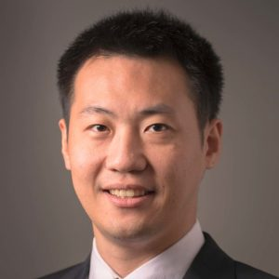

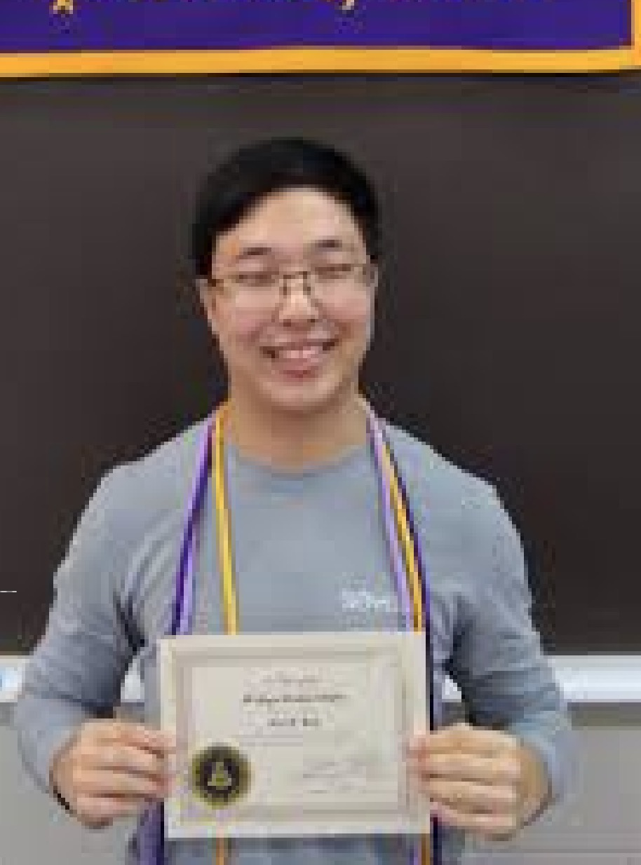
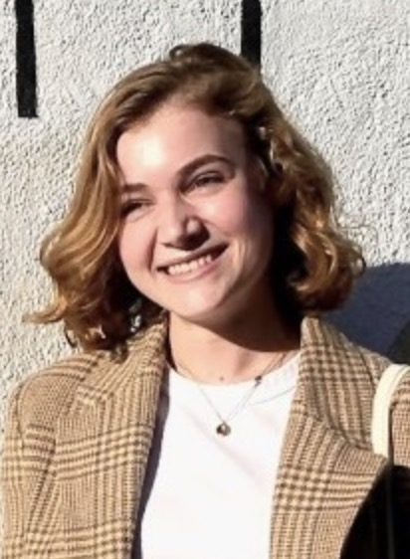
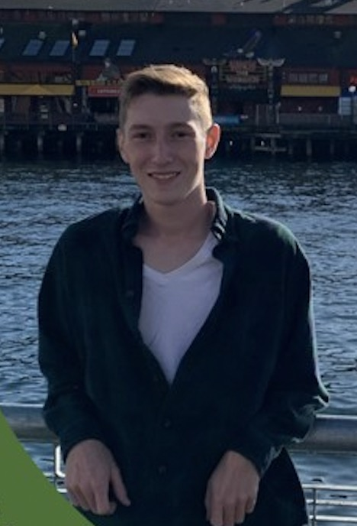

Learning to Augment Graph Data
from Node- and Link-level tasks to Graph-level
IIS-2146761
PI:
GRA:
REU:
Supervised Learning
Given only 500 labeled graphs, can we create synthetic labeled examples?
III: Small:
Comprehensive Methods to Learn to Augment Graph Data
(2022-2025, $515,999)
Imbalanced Learning
Given imbalanced numeric labels where we are interested in minor areas, can we create synthetic labeled examples to make data balanced?
Transfer Learning
Given 1.2 million unlabeled graphs and diverse downstream tasks (~500 labeled graphs each), can we guarantee positive transfer from unlabeled data?

Slide 13
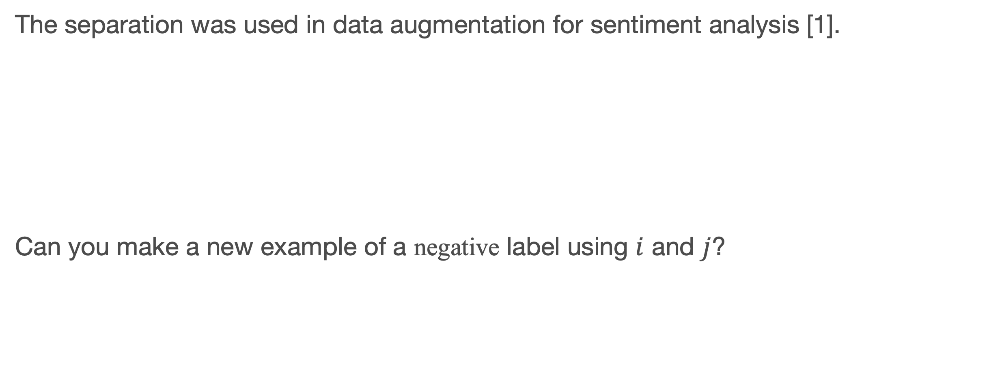
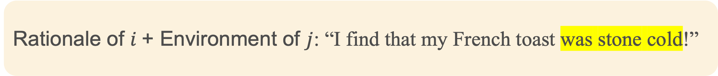
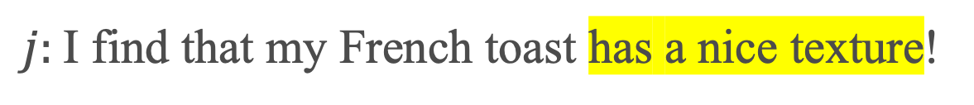
Augment by Rationale-Environment Separation
KDD’22
Gang Liu
The separation was used in data augmentation for sentiment analysis [1].
Can you make a new example of a negative label using $i$ and $j$?
negative
$i:$I’ve just got home and one of my burgers was stone cold.
“Environments”
“Rationales”
$j:$I find that my French toast has a nice texture!
positive
Rationale of $i$+ Environment of $j$: “I find that my French toast was stone cold!”
[1] Abonizio et al. “Toward text data augmentation for sentiment analysis.” TAI 2021.

Slide 14
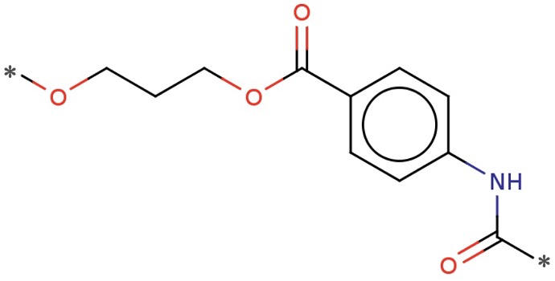
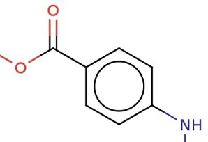
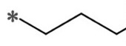
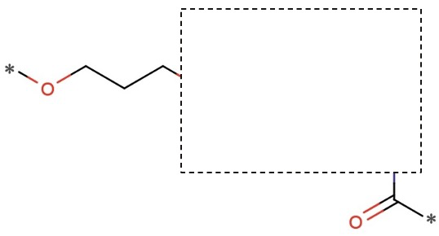
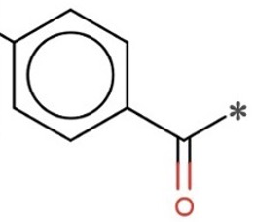
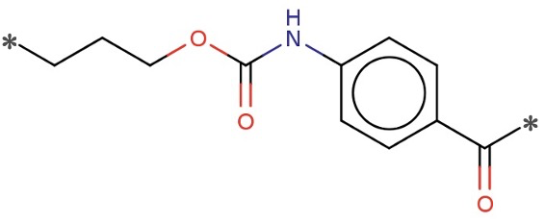










Augment by Rationale-Environment Separation
KDD’22
Gang Liu
Environment replacement on molecule/polymer graphs [1]:
$$f_{sep}$$
$$g_{i}^{(r)}$$
$g_{(i;j)}=g_{i}^{(r)}∪g_{j}^{(e)}$
What is likely its label?
$$g_{i}^{(e)}$$
$$(g_{i},y_{i})$$
$$g_{j}^{(r)}$$
$$g_{j}^{(e)}$$
However, combining two chemical subgraphs is scientifically challenging!
$$(g_{j},y_{j})$$
[1] Liu et al. “Graph rationalization with environment-based augmentations.” KDD 2022.

Slide 15














Augmentation in Latent Space
KDD’22
Gang Liu
$$1_{N}^{⊤}⋅\left(m×H\right)$$
MLP₂(·)
$${\hat{y}}_{i}^{(r)}$$
Label $y_{i}$
GNN₁(·)
MLP₁(·)
…
$$h_{i}^{(r)}$$
for Rationale $g_{i}^{(r)}$
$m$: Node’s probability of being classified into Rationale
Graph $g_{i}$
…
AGG(·, ·)
MLP₂(·)
$${\hat{y}}_{(i;j)}$$
GNN₂(·)
$$1_{N}^{⊤}⋅\left((1_{N}−m)×H\right)$$
$$h_{i}^{(e)}$$
for Environment $g_{i}^{(e)}$
$H$: Node representations
$h_{(i;j)}$: Environment-replaced example $g_{(i;j)}=g_{i}^{(r)}∪g_{j}^{(e)}$
Graph $g_{j}$
…
$h_{j}^{(e)}$: Environment $g_{j}^{(e)}$
Increased molecule classification AUC from .738 to .779 on HIV, from .766 to .819 on BASE (drug).
Reduced polymer regression MAE from 60.6 to 42.6 on MeltingTemp, from 770 to 524 on O₂Perm.
Graph data augmentation can be performed in latent space!
[1] Liu et al. “Graph rationalization with environment-based augmentations.” KDD 2022.

Slide 16
Learning to Augment Graph Data
from Node- and Link-level tasks to Graph-level
IIS-2146761
PI:
GRA:
REU:
Supervised Learning
Given only 500 labeled graphs, can we create synthetic labeled examples?
III: Small:
Comprehensive Methods to Learn to Augment Graph Data
(2022-2025, $515,999)
Imbalanced Learning
Given imbalanced numeric labels where we are interested in minor areas, can we create synthetic labeled examples to make data balanced?
Transfer Learning
Given 1.2 million unlabeled graphs and diverse downstream tasks (~500 labeled graphs each), can we guarantee positive transfer from unlabeled data?

Slide 17






Augment for Label Balance in Regression
KDD’23
Gang Liu
Can self-training fully address label imbalance in graph regression? [1]
$$𝒢_{imb}$$
$$𝒢_{imb}∪𝒢_{conf}$$
Given $y$
still imbalanced
$$𝒢_{unlabel}$$
$$𝒢_{conf}$$
$$𝒢_{aug}$$
1.2 million
Explicit label-anchored graph decoding is technically challenging!
[1] Liu et al. “Semi-supervised graph imbalanced regression.” KDD 2023.

Slide 18





In Latent Space: Label-anchored Mix-up
KDD’23
Gang Liu
Given a target label value $y$:
1. Sample a labeled example $\left(G_{j}{{∈𝒢}_{imb}∪𝒢}_{conf},y_{j}\right)$
2. Get $h_{j}=GNN(G_{j})$
3. Sample a label interval $\left(z_{i},a_{i}\right)$
4. Constrain the sampling processes:
$h=λ∙z_{i}+(1−λ)∙h_{j}$
s.t. $y=λ∙a_{i}+(1−λ)∙y_{j}$
5. Augment with $\left(h,y\right)$
$i$-th label interval
$$z_{i}=mean(\left\{h′\right\})$$
$$a_{i}=mean(\{y′\})$$
$$1,2,3,…$$
$$…,C$$

Slide 19



Augment by Label-anchored Mix-up
KDD’23
Gang Liu
Semi-supervised graph imbalanced regression (SGIR):
$$𝒢_{imb}$$
$$𝒢_{imb}∪𝒢_{conf}$$
$${𝒢_{imb}∪𝒢}_{conf} {∪H}_{aug}$$
$$𝒢_{unlabel}$$
$$𝒢_{conf}$$
$$H_{imb}∪H_{conf}$$
$$H_{aug}$$
Reduced molecule regression MAE on FreeSolv from 1.154 to .777 in few-shot area, from .726 to .563 in all areas. Reduced polymer regression MAE on MeltingTemp from 54.7 to 51.4 in few-shot, from 41.8 to 38.9 in all areas.
Again, graph data augmentation can be performed in latent space!

Slide 20


Exciting Results and Effort
from Graph Regression and Data Augmentation to Polymer Informatics
IIS-2146761
PI:
GRA:
REU:
Found two novel polymers in gas separation. Patents under review.
CBET-2332270
PI:
Co-PI:
III: Small:
Comprehensive Methods to Learn to Augment Graph Data
(2022-2025, $515,999)
CBET: Developing and Understanding Thermally Conductive Polymers by Combining Molecular Simulation, Machine Learning and Experiment
(2024-2026, $405,726)
NeurIPS 2024 competition:
Open Polymer Challenge.
Under review.
A data-centric cyber platform for polymer-by-design. Under construction.
Polymer property prediction
Polymer inverse design

Slide 21

Task data guide Graph Diffusion Transformer
NeurIPS’23
Gang Liu
Minimal sufficiency for graph generation [1]:
$L_{1}$: maximize the difference between $G$ and $G^{(D)}$
$L_{2}$: minimize the difference between $y$ and $\hat{y}$
New opportunity to learn from unlabeled graphs
[1] Liu et al. “Data-centric learning from unlabeled graphs with diffusion model.” NeurIPS 2023.

Slide 22
Data-Centric Transfer
NeurIPS’23
Gang Liu
Patterns learned from self-supervised tasks (e.g., reconstruction, perturbation) might not be aligned or even conflicting with downstream predictions.
Parameter-centric transfer:
Parameter initialization could hardly interpret how unlabeled graphs were able to improve prediction models.

Slide 23

Data-Centric Transfer
NeurIPS’23
Gang Liu
SSL may have negative impact on downstream.
Augment downstream datasets by graph generation.
Experts can evaluate and control the transfer.

Slide 24
When Material Science meets Generative AI
Take Away
Graph data augmentation can improve property prediction. It can be implicit or explicit.
Graph data augmentation can address labeled data scarcity and imbalance.
Diffusion transformer works for not only video creation but also material science.
Interesting directions:
Guide generative models with multiple desired properties [1]
Guide with domain knowledge such as motifs [2]
Guide with knowledge from material science literature and large language models (LLMs)
[1] Liu et al. “Inverse molecular design with multi-conditional diffusion guidance.” https://arxiv.org/abs/2401.13858
[2] Inae et al. “Motif-aware attribute masking for molecular graph pre-training.” https://arxiv.org/abs/2309.04589

Slide 25

Polymer Science
Modeling
Polymers with Neural Networks
Gang Liu, Eric Inae,
Meng Jiang

Slide 26
Material Science
Online Education
Software & Network Security
Mental Health

Slide 27





When Online Learning meets Generative AI
Collaboration with UIUC and Gallaudet University - private university in Washington, D.C., for the education of the deaf and hard of hearing (DHH)
IIS-2119531
PIs:
RETTL: Collaborative Research: Advancing STEM Online Learning by Augmenting Accessibility with Explanatory Captions and AI
(2021-2024, $849,994)
This this easy left x equation ok
Improving Learning Effectiveness
1
Quiz Generation (QG)
LMs
Knowledge
Question Answering (QA)
Reasoning Abilities
2
Instructor’s
Learning Goals
Student / Classroom Simulation

Slide 28




Reasoning in Natural Language
EMNLP’23 (Outstanding Paper Award), EMNLP’22, ACL’22
Mengxia Yu
Wenhao Yu (Tencent)
Comparative Reasoning [1]
Counterfactual Reasoning [2]
Created numerous training pairs with open (un-)structured data
Pre-trained LMs continually for zero/few-shot comparative QA/QG
IfQA
Collected 3,800+ questions that have counterfactual presuppositions
Evaluated supervised retrieve-then-read and GPT prompting
Commonsense Reasoning [3]
Abductive Reasoning [4]
[1] Yu et al. “Pre-training language models for comparative reasoning.” EMNLP 2023.
[2] Yu et al. “IfQA: Open-domain question answering under counterfactual presuppositions.” EMNLP 2023. (Outstanding paper award)
[3] Yu et al. “Retrieval augmentation for commonsense reasoning: a unified approach.” EMNLP 2022.
[4] Yu et al. “Diversifying content generation with mixture of knowledge graph experts.” ACL 2022.

Slide 29
Multi-choice Commonsense Question Answering
Commonsense Fact Verification
Where can I stand on a river to see water falling without getting wet?
A pound of cotton has the same weight as a pound of steel.
A) waterfall
B) bridge
C) valley
D) stream
E) bottom
True
False
Datasets:
OpenBookQA: Clark et al. arxiv 2018. (5,957 questions)
CommonsenseQA 1.0： Talmor et al. NAACL 2019. (12,102)
Evaluation: Accuracy.
Datasets:
CommonsenseQA 2.0: Talmor et al. (14,343 assertions)
CREAK： Onoe et al. NeurIPS 2021 Benchmark Track. (13,000)
Evaluation: Accuracy.
Constrained Commonsense Generation
Counterfactual Explanation Generation
Constraints: dog, frisbee, catch, throw
I am hungry for water.
Description: A girl throws a frisbee and her dog catches it.
Outputs:
1) Water is used to quench thirsty.
2) You are thirsty for water, not hungry.
3) Water is not food.
Datasets:
CommonGen: Lin et al. Findings of EMNLP 2020. (79,000+ commonsense descriptions)
Evaluation: SPICE, BLEU-4, ROUGE-L, CIDEr.
Datasets:
ComVE: Wang et al. SemEval-2020 Task 4 (11,997 examples)
Evaluation: SPICE, BLEU-4, ROUGE-L, CIDEr.

Slide 30
Retrieval Augmentation
Unified Approach for Commonsense Reasoning (RACo) [1]
Wenhao Yu (Tencent)
Dense Passage Retriever
Large-scale
Commonsense
Text Dataset
Commonsense Corpora
Source Heterogeneity
(e.g., transform KG / KB)
Commonsense Knowledge Graphs
(from human annotated relations)
Commonsense Knowledge Bases
(from a large collection of facts and events)
Input
Retrieved Passages
Output
Multi-choice Commonsense Question Answering
Generator
(as classifier if needed)
Commonsense Fact Verification
Constrained Commonsense Generation
Counterfactual Explanation Generation
[1] Yu et al. “Retrieval augmentation for commonsense reasoning: a unified approach.” EMNLP 2022.

Slide 31
Multi-choice Commonsense Question Answering
Commonsense Fact Verification
(Accuracy) | CSQA1.0 | OBQA
RACo | 75.76 | 71.25
GreaseLM | 74.20 | 66.90
QA-GNN | 73.40 | 67.80
UNICORN | 71.60 | 70.02
T5-Large | 70.14 | 66.02
KAGNet | 69.00 | -
(Accuracy) | CSQA2.0 | CREAK
RACo | 61.75 | 84.17
UNICORN | 54.90 | 79.51
GreaseLM | - | 77.51
T5-Large | 54.60 | 77.32
🏆
🏆
Constrained Commonsense Generation
Counterfactual Explanation Generation
CommonGen | (BL-4) | (SPICE)
RACo | 42.76 | 33.89
KFCNet | 41.97 | 33.11
UNICORN | 39.86 | 33.20
KG-BART | 30.90 | 32.70
CALM | 29.50 | 30.20
T5-Large | 28.60 | 31.60
ComVE | (BL-4) | (SPICE)
RACo | 25.30 | 36.37
UNICORN | 24.46 | 35.79
CALM | 23.50 | 35.23
MoKGE | 22.87 | 34.88
T5-Large | 22.77 | 34.62
GraphRF | 22.07 | 33.09
🏆
🏆

Slide 32





Knowledge-Augmented NLP
“Open-Book” and Knowledge Heterogeneity
External
knowledge
sources
Survey paper:
A Survey of Knowledge-Enhanced Text Generation. ACM Computing Surveys, 2022.
Tutorials:
Knowledge-Enriched Natural Language Generation. EMNLP 2021.
Knowledge-Augmented Methods for NLP. ACL 2022.
Knowledge-Augmented Methods for NLP. WSDM 2023.
Workshops:
KnowledgeNLP-AAAI 2023. https://knowledge-nlp.github.io/aaai2023/
KnowledgeNLP-KDD 2023. https://knowledge-nlp.github.io/kdd2023/
KnowledgeNLP-ACL 2024. https://knowledge-nlp.github.io/acl2024/ (August 11-16 in Bangkok, Thailand)
Wikipedia
News
Database
Social media
…
Retriever
Input
Knowledge
(e.g., passages)
Output
tasks
Reader, Generator, or Large Language Model

Slide 33







Reasoning in Natural Language
EMNLP’23 (Outstanding Paper Award), EMNLP’22, ACL’22
Mengxia Yu
Wenhao Yu (Tencent)
Comparative Reasoning [1]
Counterfactual Reasoning [2]
Created numerous training pairs with open (un-)structured data
Pre-trained LMs continually for zero/few-shot comparative QA/QG
IF …
Collected 3,800+ questions that have counterfactual presuppositions
Evaluated supervised retrieve-then-read and GPT prompting
Commonsense Reasoning [3]
Abductive Reasoning [4]
Integrated heterogeneous knowledge into a corpus by data-to-text
Developed retrieval augmentation as a unified (best) approach for 4 tasks
?
Went to work,
leaving windows open
Back home
Found a mess
[1] Yu et al. “Pre-training language models for comparative reasoning.” EMNLP 2023.
[2] Yu et al. “IfQA: Open-domain question answering under counterfactual presuppositions.” EMNLP 2023. (Outstanding paper award)
[3] Yu et al. “Retrieval augmentation for commonsense reasoning: a unified approach.” EMNLP 2022.
[4] Yu et al. “Diversifying content generation with mixture of knowledge graph experts.” ACL 2022.

Slide 34


Scientific Text Intelligence
Knowledge-augmented Comparative and Abductive Reasoning
IIS-2119531
PIs:
IIS-2234058
PI:
GRA:
RETTL: Collaborative Research: Advancing STEM Online Learning by Augmenting Accessibility with Explanatory Captions and AI
(2021-2024, $849,994)
III: Small:
Intelligent Scientific Text Analytics with
Knowledge-augmented Abductive Reasoning
(2023-2026, $599,962)

Slide 35





When Software & Network Security meets Generative AI
Human-oriented Knowledge Representation with Text and Graph
Text generation on graph: To build a taxonomy, concepts can be generated word by word to address low recall [1].
CCF-1901059
PI:
IIS-1849816
PI:
SHF: Medium: Collaborative Research: Semantically-Enhanced Software Traceability for Supporting Human-Centric Tasks
(2019-2024, $1,035,030)
CRII: III: Beyond Similarity Learning: Complementarity Learning for Contextual Behavior Modeling
(2019-2021, $174,910)
Qingkai Zeng
Text generation from tree: LLMs can interpret decision tree predictions with domain knowledge to experts who know little about machine learning [2, 3].
N00014-22-1-2507
PI:
“Towards Third Generation Network Intrusion Detection and Prevention Systems
(2022-2025, $459,251)
Noah Ziems
[1] Zeng et al. “Enhancing taxonomy completion with concept generation via fusing relational representations.” KDD 2021.
[2] Ziems et al. “Explaining tree model decisions in natural language for network intrusion detection.” NeurIPS-XAIA 2023.
[3] Ziems et al. “Large language models are built-in autoregressive search engines.” ACL 2023.

Slide 36


Material Science
Online Education
Software & Network Security
Mental Health

Slide 37







When Suicidal Ideation meets Generative AI
Specialized Generative AI for Specialized IA
IIS-2142827
PI:
GRA:
r/SuicideWatch [1, 2]
Peer support for anyone struggling with suicidal thoughts
467K Members
1R21MH129688
PI:
CAREER: Synergistic Approaches for Specialized Intelligent Assistance
(2022-2027, $549,969)
Advancing Real-Time Suicide Risk Detection through Digital Phenotyping
(2022-2024, $430,375)
GPT-5?
Joint PhD program:
ND Psychology | Computer Science and Engineering (CSE)
two participants: passive and active risk profiles that culminated in suicidal crises and subsequent psychiatric hospitalization [3]
[1] Jiang et al. “Phrase-level pairwise topic modeling to uncover helpful peer responses to online suicidal crises.” Nature Humanities and Social Sciences Communications 2020.
[2] Dang et al. “Embedding mental health discourse for community recommendation.” ACL-CODI 2023.
[3] Jacobucci et al. “A comparative case analysis of passively collected smartphone-based data in the days prior to psychiatric hospitalization for a suicidal crisis.” Open Science Framework 2024.
Screenomics screenshot capture
Ecological momentary assessment (EMA)

Slide 38
Conclusions
Doing interdisciplinary research with Generative AI is lots of fun!
Material Science | Polymer Informatics
Graph data augmentation
Supervised learning; Imbalanced learning; Transfer learning
Implicit aug.: Environment (non-Rationale) replacement; Label-anchored mix-up
Explicit aug.: Parameter- or data-centric transfer; Graph diffusion transformer
Online Education (for DHH)
Knowledge-augmented NLP
Question answering; Question generation
Knowledge heterogeneity; Multiple types of Reasoning (e.g., Comparative, Abductive)
Software & Network Security and Mental Health | Suicide Prevention

Slide 39

Welcome to visit us in South Bend!
http://www.meng-jiang.com/lab.html
https://github.com/DM2-ND
mjiang2@nd.edu
38

